Slide 1
Intro to Gradient Descent
NLP with Representation Learning
Fall ‘22
Will Merrill

Slide 2
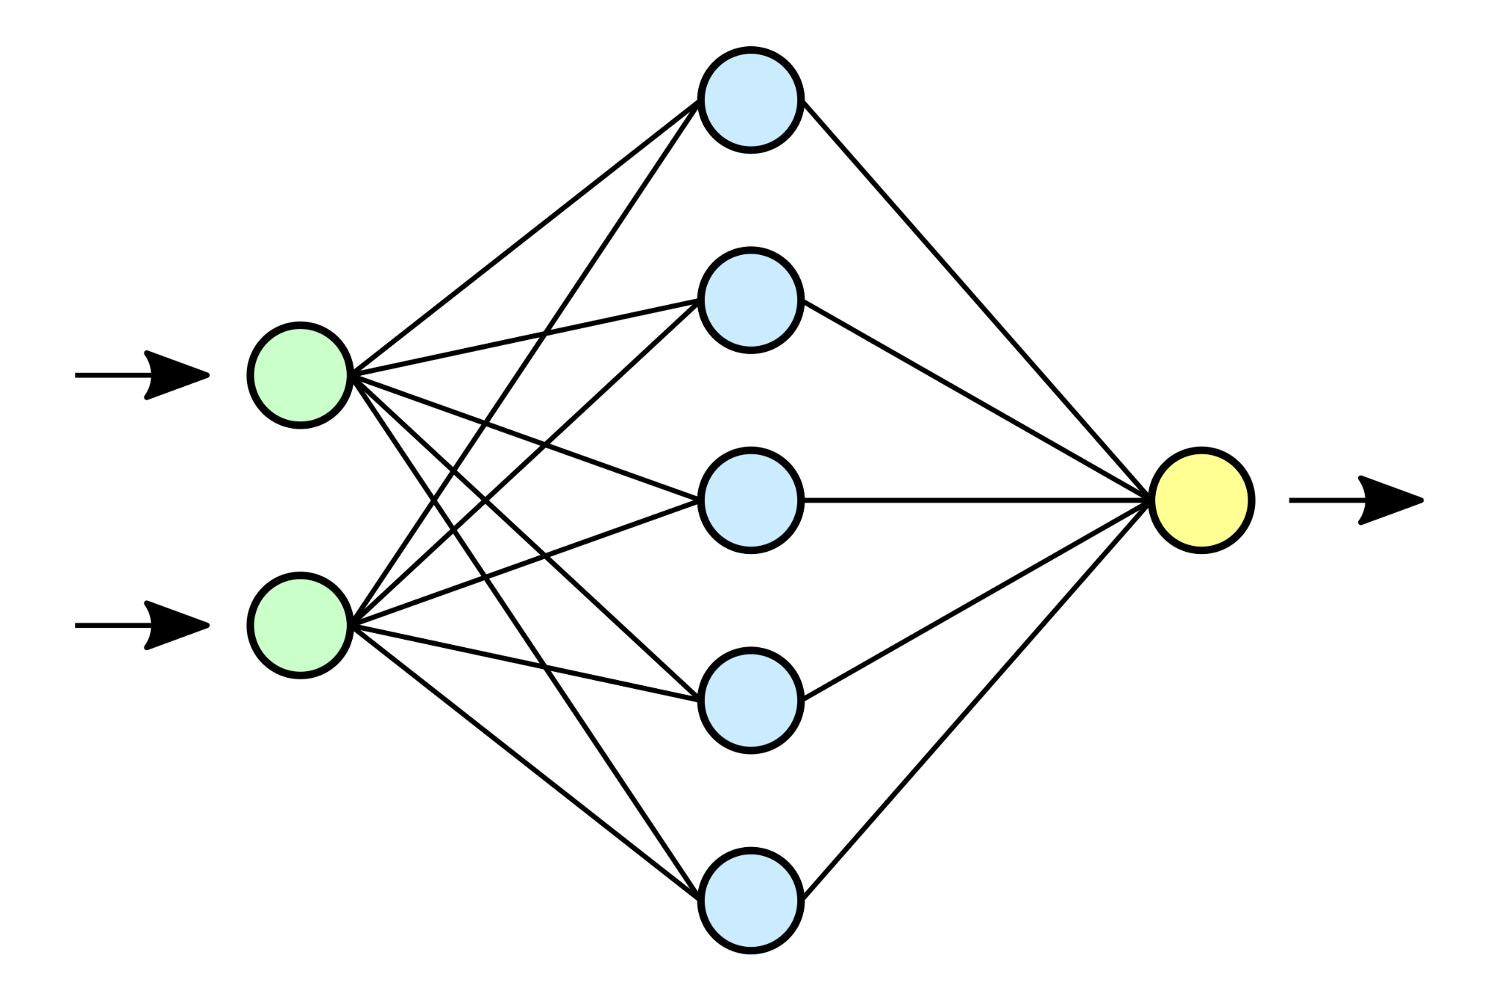
Relationship between neural networks and gradient descent?
Neural network: a way to express functions as “cells” connected by weights
Gradient descent: a way to learn weights in a neural network

Slide 3
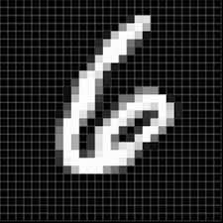
Loss functions
To use gradient descent, need loss function L(x, θ)
How “wrong” is the model on the data x (with current weights θ)?
Input:
Prediction:
Input:
Prediction:
6: 90%
5: 10%
5: 90%
6: 10%
L(x, θ) = 0.15 Low!
L(x, θ) = 3.32 High!

Slide 4
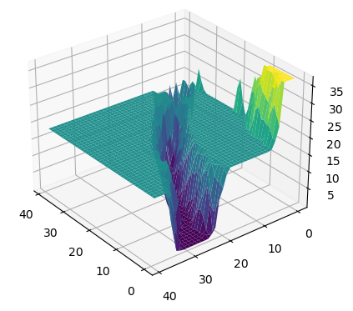
Loss landscape
L(θ) = avg L(x, θ) over full dataset
Plot of L(θ) given all values of θ
With >1 parameter, this is high-dimensional manifold

Slide 5
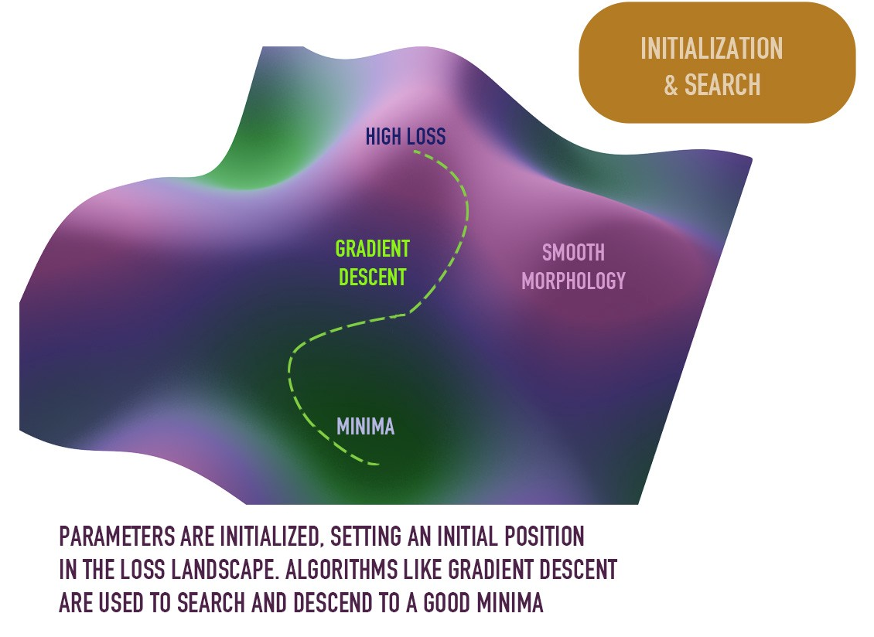
Learning as optimization
Goal of learning: change the weights to minimize the loss
≈ rolling a ball down the loss landscape
Q: What mathematical tool is useful for following the slope down a hill?
A: Derivatives, which become gradients in higher dimensions

Slide 6
Gradient descent
∇L(θ) = gradient of loss L w.r.t. parameters θ
Gradient descent computes updated parameters θ’ according to (η > 0):
θ’ = θ - η * ∇L(θ)
Discussion questions (3 min with neighbor):
What does -∇L(θ) represent in the loss landscape?
Explain the intuition behind the gradient descent update rule. Drawing a picture may help.

Slide 7
Summary
Gradient descent is a way of learning neural net’s parameters
To learn with gradient descent, need to compute:
gradients of loss (w.r.t. parameters)
We will see next how PyTorch lets us compute these gradients efficiently

